Slide 1
Thyatira: Involved Yet Immoral
Rick Griffith • Crossroads International Church • BibleStudyDownloads.org
Notes:
Revelation 2:18-29 Thyatira—Involved Yet Immoral
Unfortunately, at times even a church can condone sexual immorality. It happens every day now as churches redefine and explain away God's definition of marriage. In his letter to the church of Thyatira, Jesus tells us how seriously he views us calling sin simply "alternative" or "acceptable" or "tolerant" views. In particular, pornography is destroying nations.
Tags: pornography, sexual sin, homosexuality, adultery, gay marriage, tolerance, tolerant, Thyatira, immorality

Slide 2
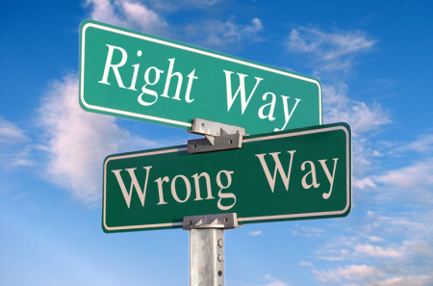
Right way, wrong way
Right Way
Wrong Way

Slide 3
Pornography

Slide 4
Pornography
AMERICA IS ADDICTED TO
PORN
Selling sex is one of the oldest businesses in the world, and right now, business has never been better. But this full-blown addiction to porn is spreading from computer and TV screens across America to homes, families, and marriages across the country at a dangerous pace.

Slide 5
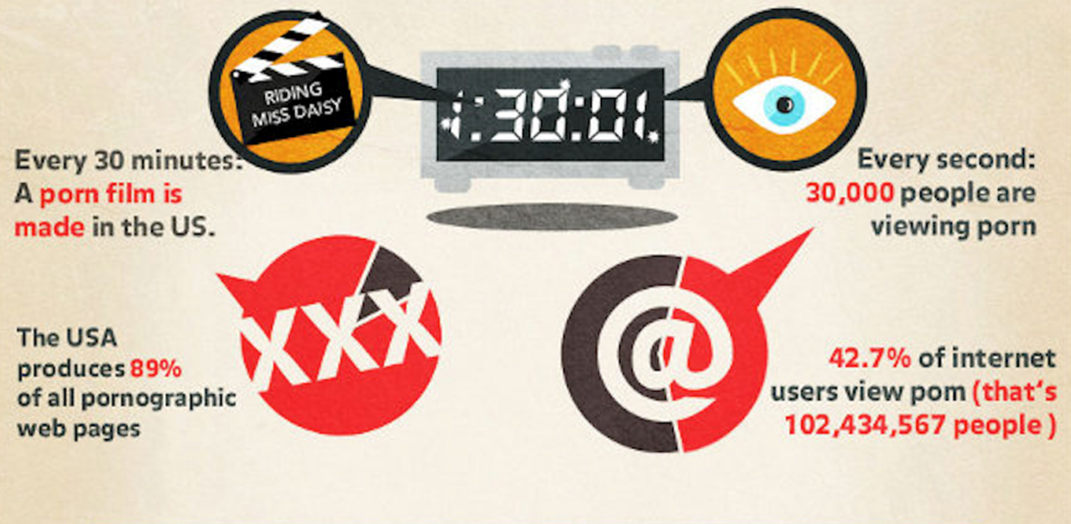
Pornography
Every 30 minutes: A porn film is made in the USA.
Every second:
30.000 people are viewing porn.
The United States produces 89% of all pornographic websites.
42.7% of internet users view porn (that’s 102,434,567 people)

Slide 6
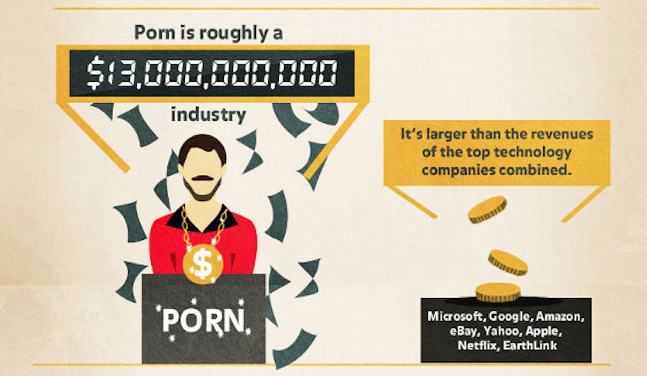
Pornography
Porn is roughly a
It’s larger than the revenues of the top technology companies combined.
industry

Slide 7
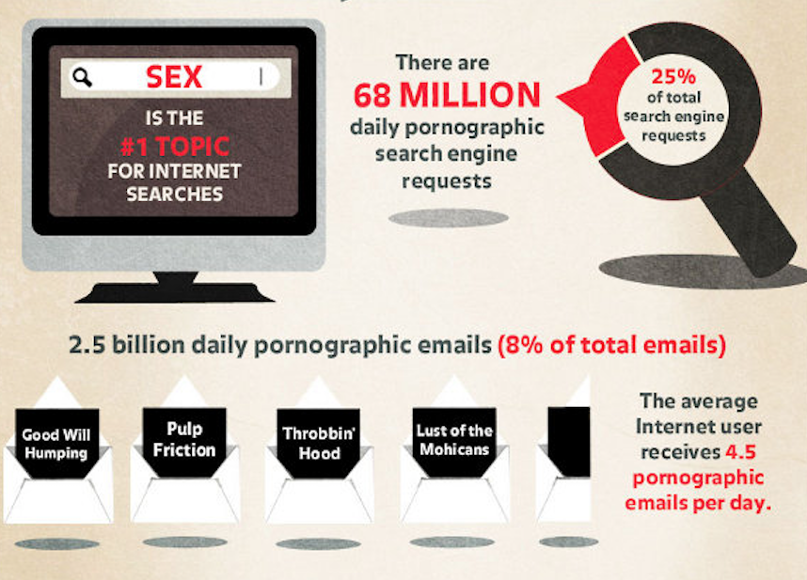
Pornography
There are:
68 MILLION daily pornographic search engine requests
25%
of all search requests
IS THE #1 TOPIC
FOR INTERNET SEARCHES
2.5 billion daily pornographic emails (8% of total emails)
The average Internet user receives
4.5 pornographic emails per day.

Slide 8
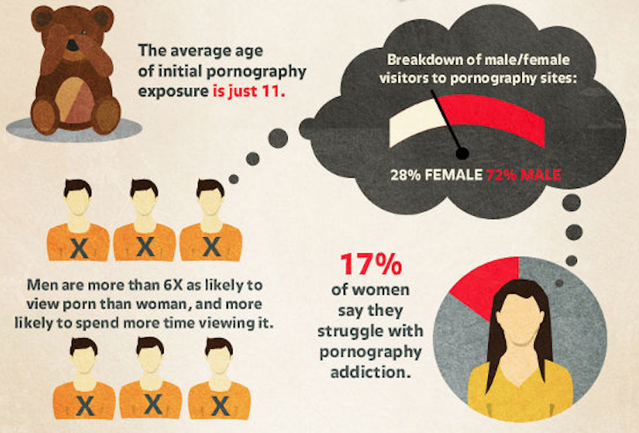
Pornography
The average age of initial pornography is just 11.
Breakdown of male/female visitors to pornography sites:
28% FEMALE 72% MEN
17% of women say they struggle with pornography addiction.
Men are more than 6X as likely to view porn than woman, and more likely to spend more time viewing it.

Slide 9
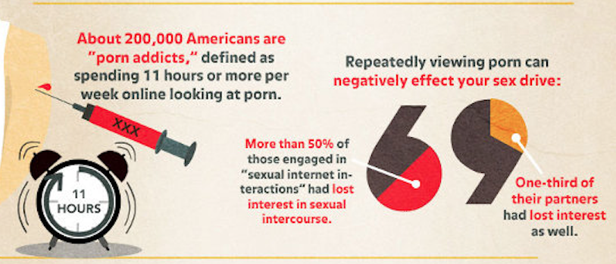
Pornography
About 200,000 Americans are “porn addicts”: defined as spending 11 hours or more per week online looking at porn.
Repeatedly viewing porn can
negatively effect your sex drive:
More than 50% of those engaged in “sexual internet interactions” had lost interest in sexual intercourse.
One-third of their partners had lost interest as well.

Slide 10
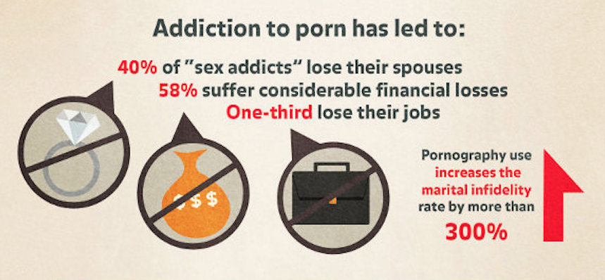
Pornography
Addiction to porn has led to:
40% “sex addicts” lose their spouses
58% suffer considerable financial losses
One-third lose their jobs
Pornography use increases the marital infidelity rate by more than
300%

Slide 11
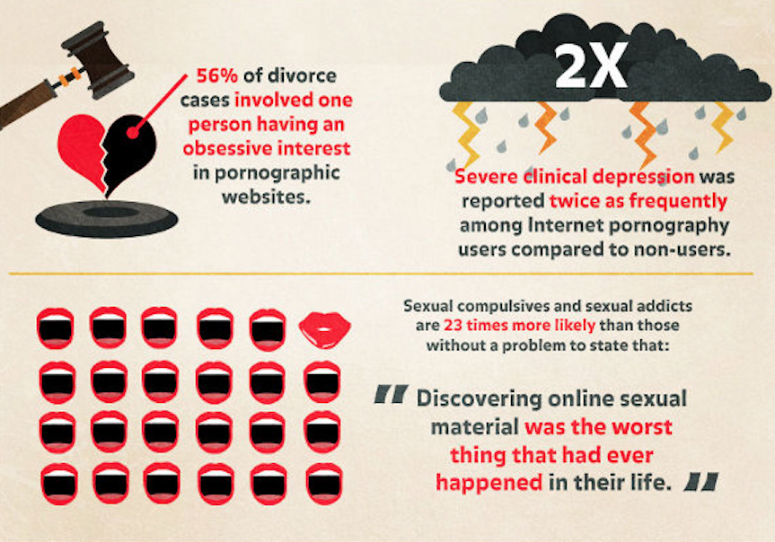
Pornography
56% of divorce cases involved one person having an obsessive interest in pornographic websites.
Severe clinical depression was reported twice as frequently among Internet pornography users compared.
Sexual compulsives & addicts are 23 times more likely than those without a problem to state that:
“Discovering online sexual material was the worst thing that had ever happened in their life.”

Slide 12
Pornography
of men aged 18-24 visit porn sites in a typical month.

Slide 13
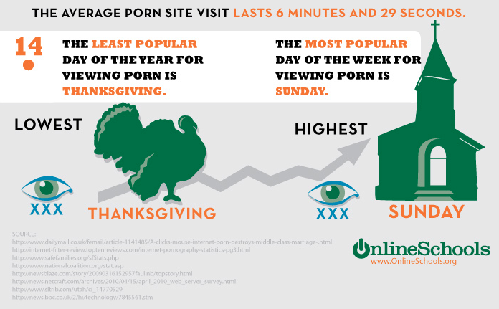
Pornography
THE AVE PORN SITE VISIT LASTS 6 MINUTES & 29 SECONDS.
THE LEAST POPULAR DAY OF THE YEAR TO VIEW PORN IS THANKSGIVING.
THE MOST POPULAR DAY OF THE WEEK TO VIEW PORN IS SUNDAY.
LOWEST
HIGHEST
THANKSGIVING
SUNDAY

Slide 14
Pornography

Slide 15
Porn in the Church

Slide 16
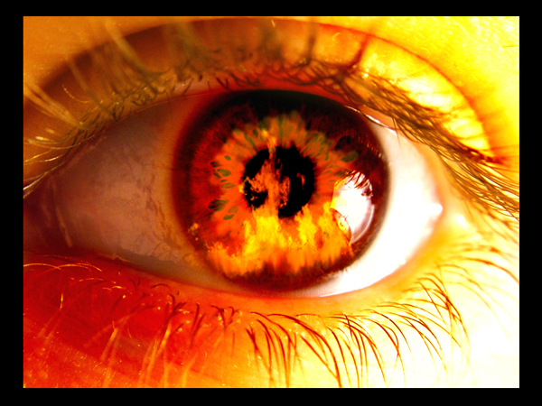
How does Jesus respond to immorality among believers?

Slide 17
If Jesus wrote a letter to our church, what would Jesus say?
R
Revelation

Slide 18
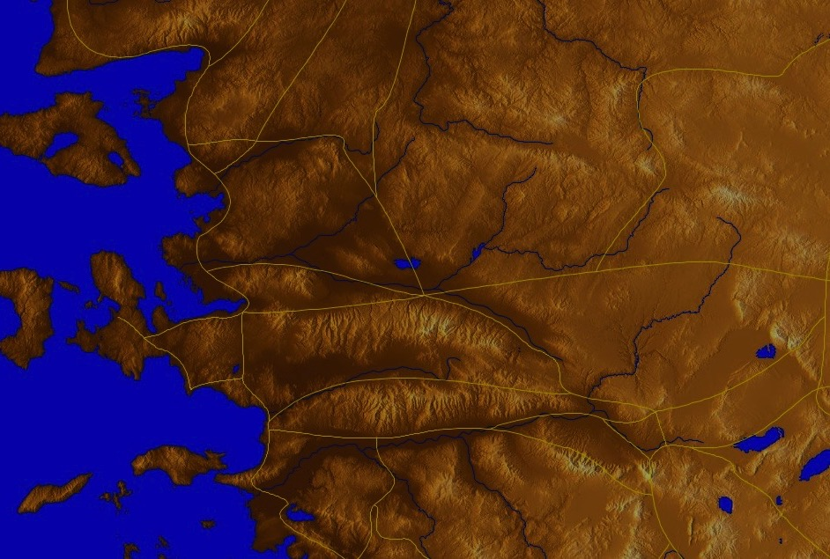
The 7 Churches (Rev. 2–3)
345
Adramyttium
Aezani
Pergamum
Thyatira
Cyme
Erythrae
Sardis
Smyrna
Eumenia
Philadelphia
Lebedus
Colophon
Ephesus
Nysa
Laodicea
Hierapolis
Trailes
Heraclea
Aphrodisias
Colossae
Alabanda
Patmos
Miletus
Notes:
Jesus designed a brilliant strategy by having his revelation sent to capital of the province, Ephesus. It included an individual letter to Ephesus, as well as letters to 6 other key churches. The Ephesians copied the entire book of Revelation, though, and sent the original to the next city, Smyrna. Smyrna then made their own copy and sent the original to Pergamum, which lay on the main road to the north. This city then sent the prophecy to Thyatira, which sent it to Sardis, then Philadelphia, and finally to Laodicea.

Slide 19
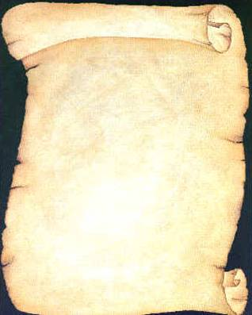
Jesus had authority over and wrote 7 churches (Rev. 2–3)
Ephesus
Smyrna
Pergamum
Thyatira
Sardis
Philadelphia
Laodicea

Slide 20
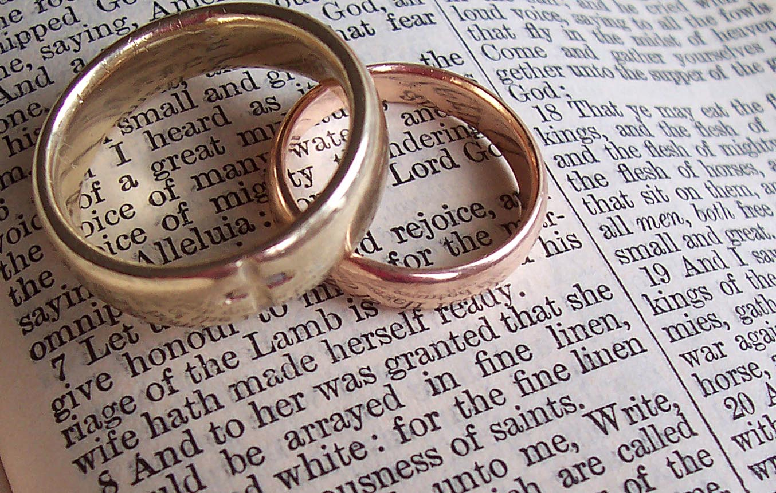
Revelation 2:18-29 Structure
Negative
Positive
Negative
Positive

Slide 21
How does Jesus respond to immorality among believers?

Slide 22
I. Jesus judges sin in believers (2:18).

Slide 23
Thyatira (Rev. 2:18-29)
345
Adramyttium
Aezani
Pergamum
Thyatira
Cyme
Erythrae
Sardis
Smyrna
Eumenia
Philadelphia
Lebedus
Colophon
Ephesus
Nysa
Laodicea
Hierapolis
Trailes
Heraclea
Aphrodisias
Colossae
Alabanda
Patmos
Miletus

Slide 24
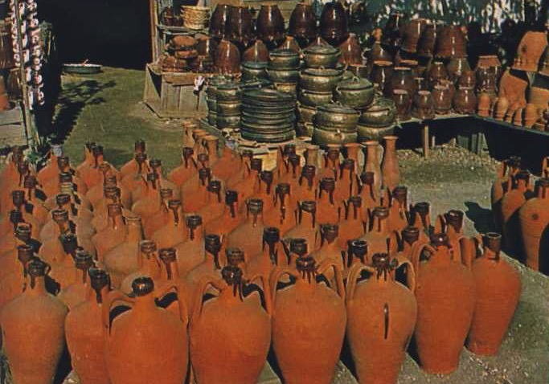
Thyatira
355
Thyatira was famous for its purple dyes and guilds for tanners, dyers, woolen and linen workers. These led to an extensive use of clay pots and pagan celebrations.
Many Christians died rather than compromise in guild festivities.

Slide 25
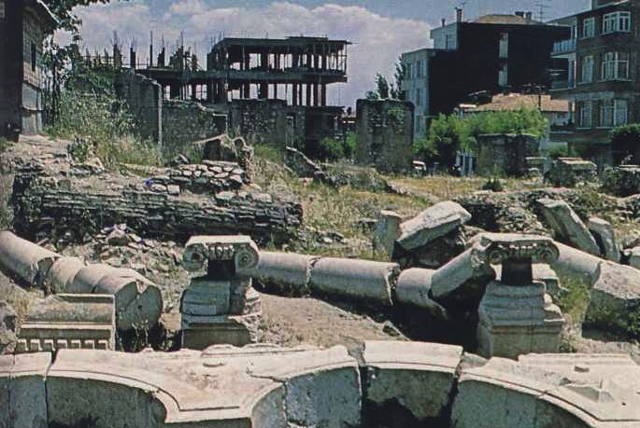
Thyatira
355
Thyatira had more trade guilds than any other city. Such guilds supported the pagan gods, so Christians had trouble supporting themselves.

Slide 26
Thyatira (Rev. 2:18-29)
355
Pergamum
Thyatira
Christ: The Son of God with eyes like blazing fire and feet like burnished brass
Smyrna
Sardis
Ephesus
Philadelphia
Laodicea

Slide 27
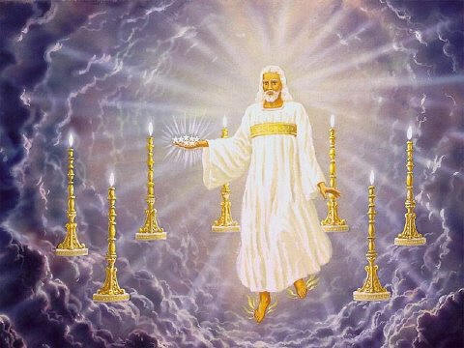
Description of Christ
"This is the message from the Son of God, whose eyes are like flames of fire, whose feet are like polished bronze" (2:18 NLT)

Slide 28
How does Jesus respond to immorality among believers?

Slide 29
II. Jesus commends service for Christ (2:19).

Slide 30
Thyatira (Rev. 2:18-29)
355
Pergamum
Thyatira
Christ: The Son of God with eyes like blazing fire and feet like burnished brass
Commendation:
Deeds, love, faith, service, perseverance, doing more than at first
Smyrna
Sardis
Ephesus
Philadelphia
Laodicea

Slide 31
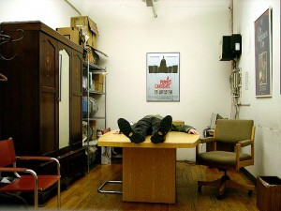
"I know all the things you do. I have seen your love, your faith, your service, and your patient endurance. And I can see your constant improvement in all these things" (2:19 NLT)

Slide 32
Who should be commended among us?

Slide 33
Miriam Burnett

Slide 34
Lewis, Barbara & Christine Winkler

Slide 35
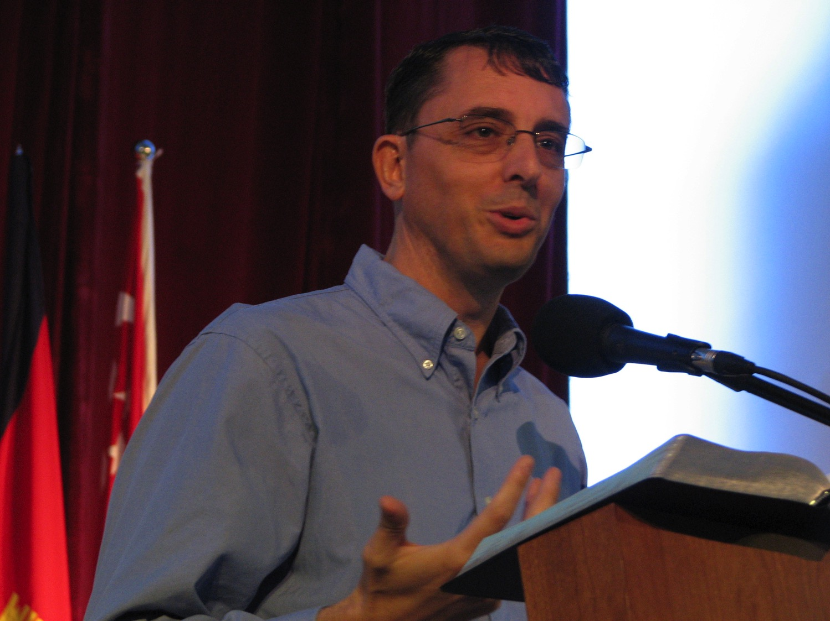
Lewis Winkler

Slide 36
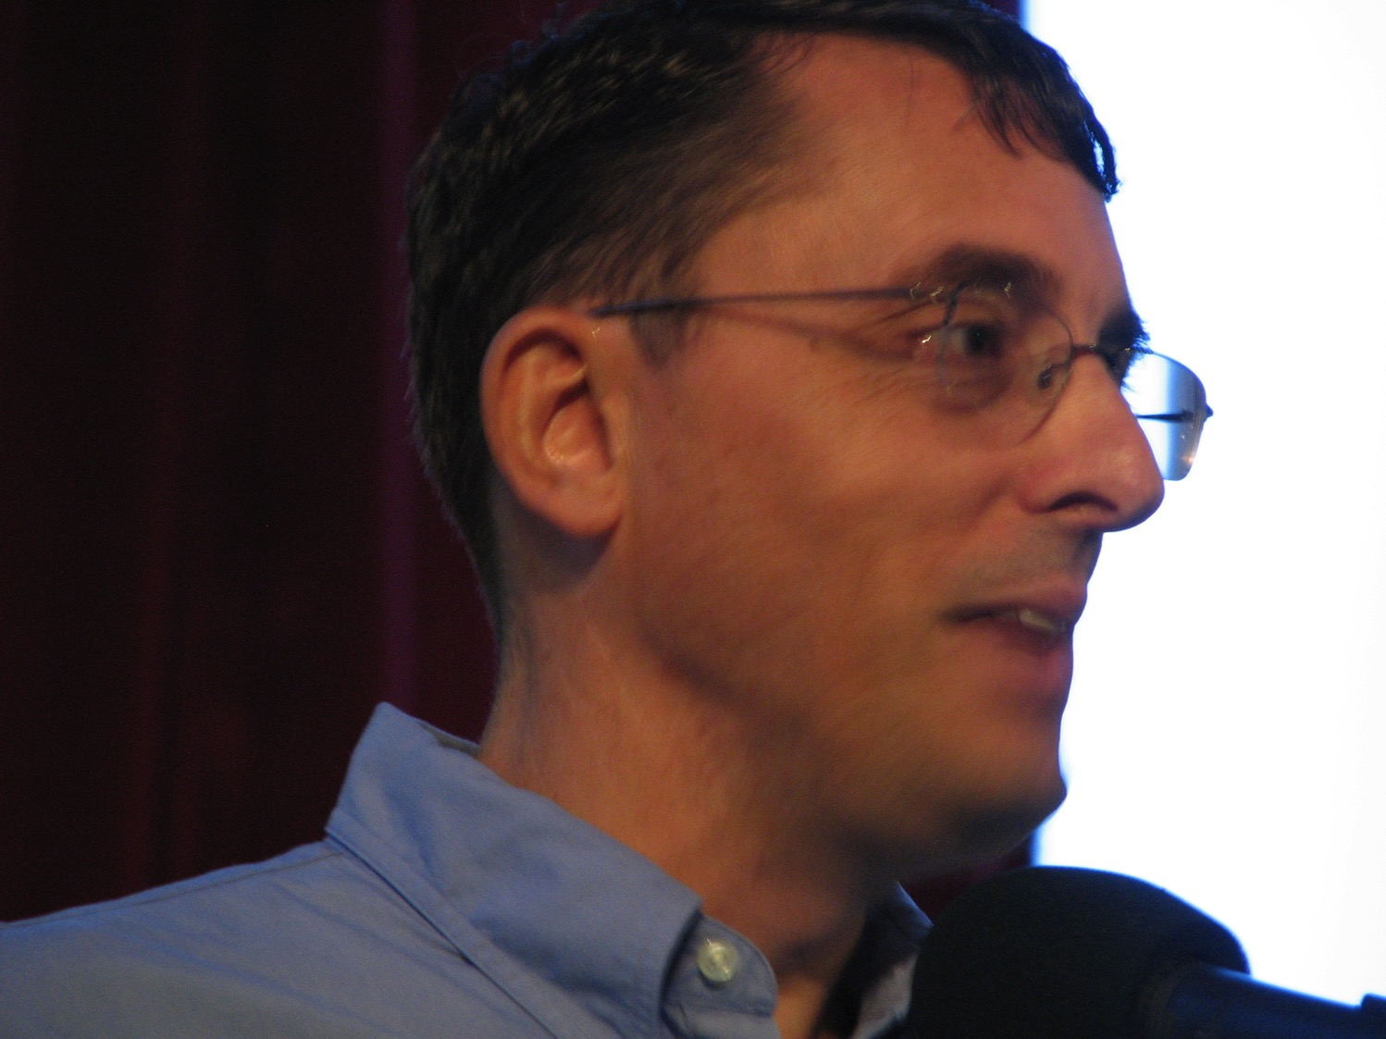
Lewis Winkler

Slide 37
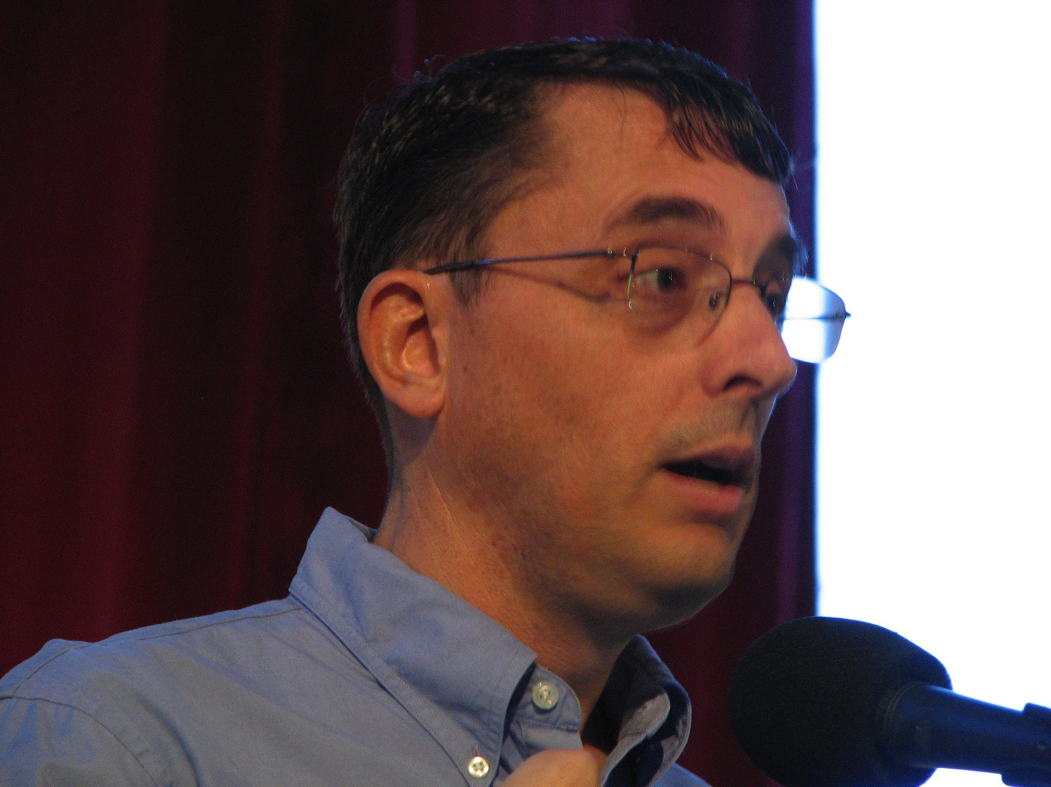
Lewis Winkler

Slide 38
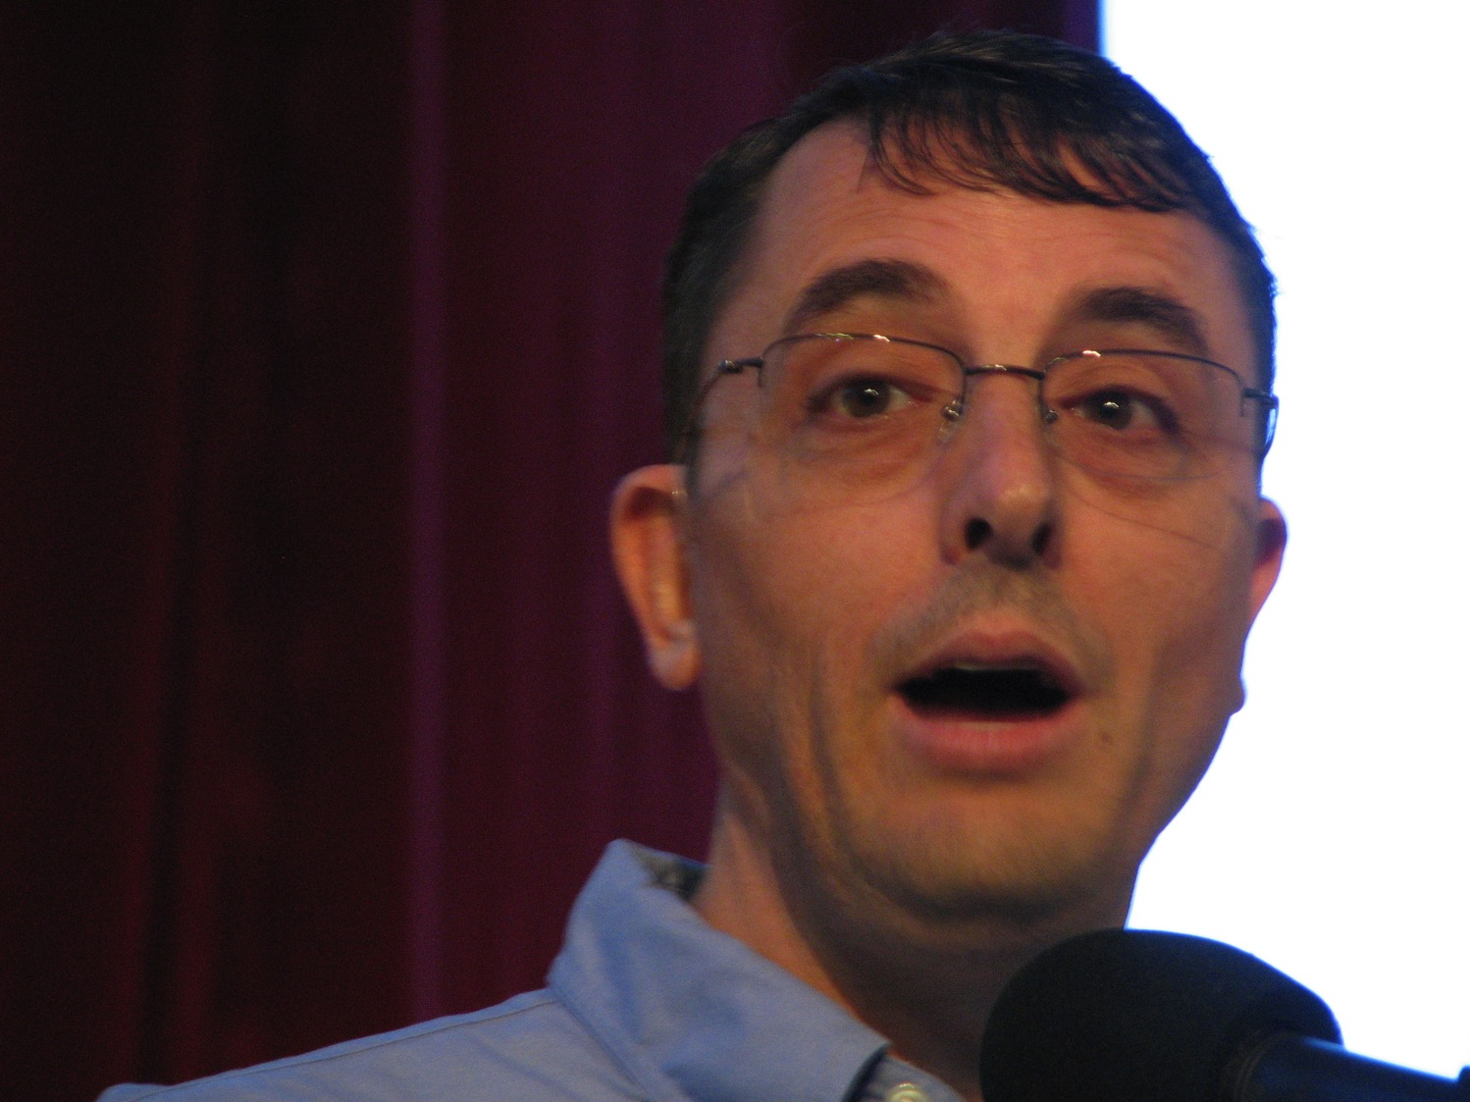
Lewis Winkler

Slide 39
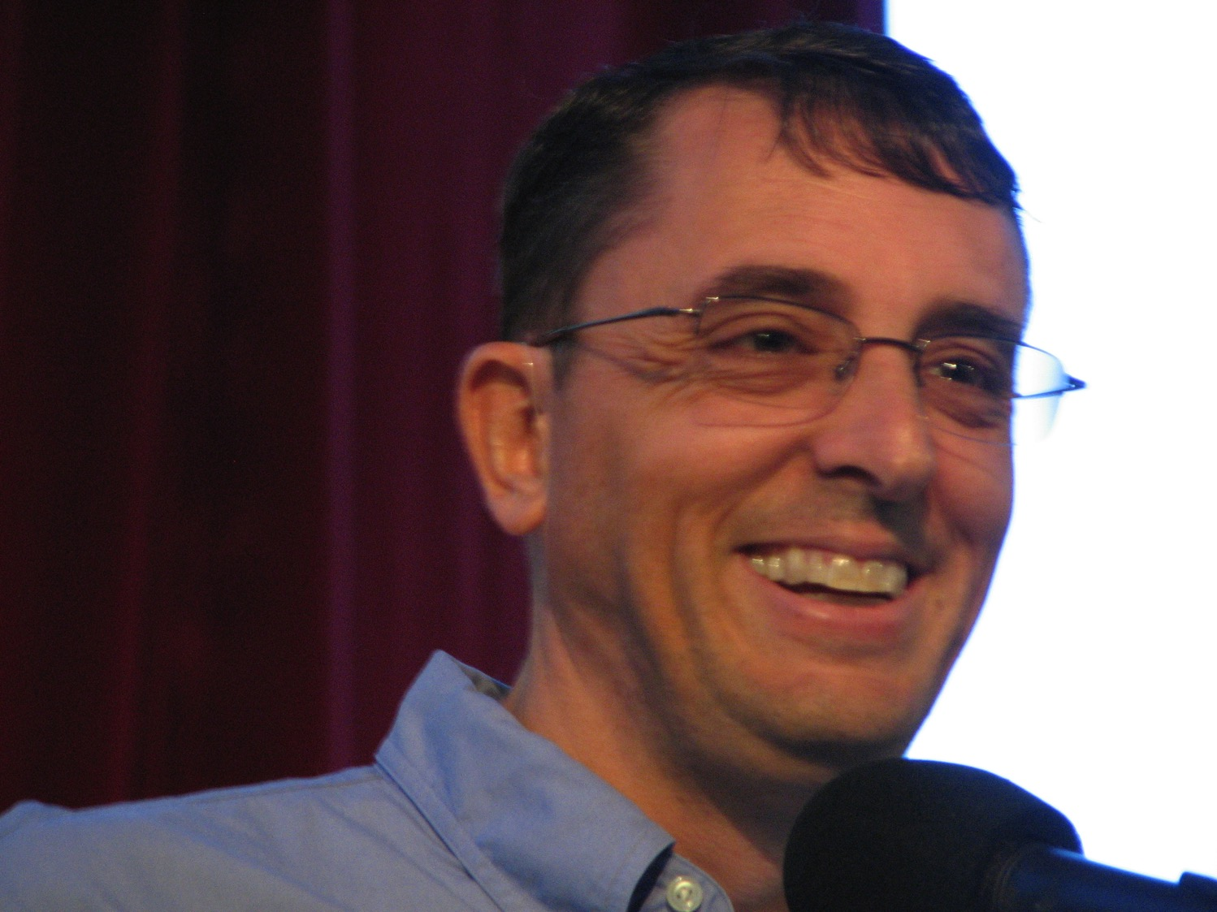
Lewis Winkler

Slide 40
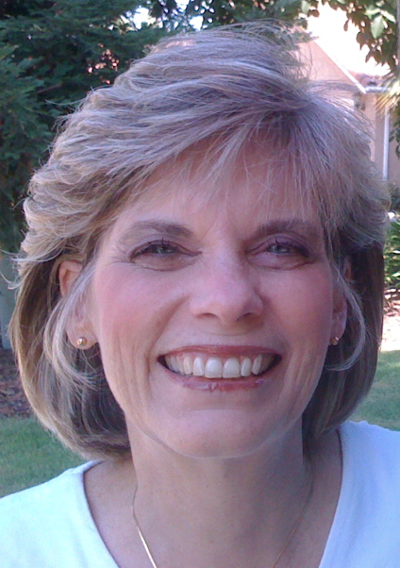
Susan Griffith

Slide 41
Jesus knows!
Excellent
Very Good
Good
Average
Poor

Slide 42
How does Jesus respond to immorality among believers?

Slide 43
III. Jesus discerns between unfaithful and faithful believers (2:20-25)

Slide 44
Thyatira (Rev. 2:18-29)
355
Pergamum
Thyatira
Rebuke
Tolerates Jezebel with her immorality and idolatry
Christ: The Son of God with eyes like blazing fire and feet like burnished brass
Commendation:
Deeds, love, faith, service, perseverance, doing more than at first
Smyrna
Sardis
Ephesus
Philadelphia
Laodicea

Slide 45
"But I have this complaint against you. You are permitting that woman—that Jezebel who calls herself a prophet—to lead my servants astray. She teaches them to commit sexual sin and to eat food offered to idols. ²¹I gave her time to repent, but she does not want to turn away from her immorality" (2:20-21 NLT)

Slide 46
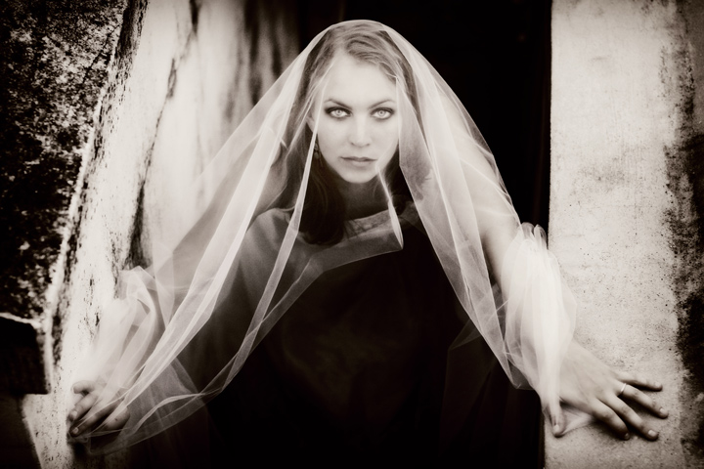
Who was Jezebel?

Slide 47
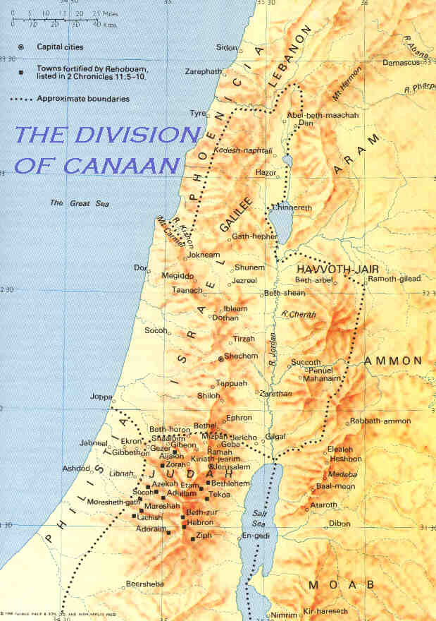
Dan
Baal
Elijah confronted 850 of Jezebel's prophets at the end of a 3.5 year drought in the land of the "thunder god" and "rain god."
Bethel
Jerusalem
1 Kings 16:31-33

Slide 48
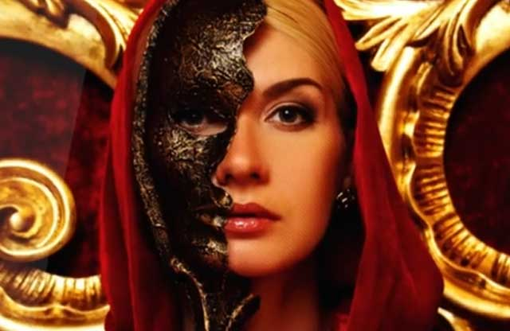
"What was acceptable to that local society was abhorred by Christ. Their departure from morality had gone on for some time (v. 21). The church in Thyatira may have first heard the gospel from Lydia, converted through Paul's ministry (Acts 16:14-15). Interestingly now a woman, a self-claimed 'prophetess,' was influencing the church. Her name 'Jezebel' suggests that she was corrupting the Thyatira church much like Ahab's wife Jezebel corrupted Israel (1 Kings 16:31-33)" (Walvoord, BKC)

Slide 49
Thyatira (Rev. 2:18-29)
355
Warning
I am bringing her [Jezebel] violent illness, and adulterers with her into terrible suffering, unless they repent; and I will strike her followers with a deadly disease, and then all the churches will know that I am the one who searches minds and hearts. I will repay each one of you what your deeds deserve.
Pergamum
Thyatira
Rebuke
Tolerates Jezebel with her immorality and idolatry
Christ: The Son of God with eyes like blazing fire and feet like burnished brass
Commendation:
Deeds, love, faith, service, perseverance, doing more than at first
Smyrna
Sardis
Ephesus
Philadelphia
Laodicea

Slide 50
HIV • AIDS

Slide 51
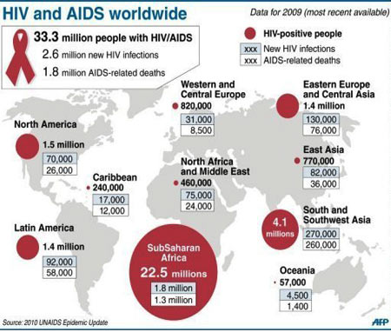
AIDS
South and Southeast Asia

Slide 52
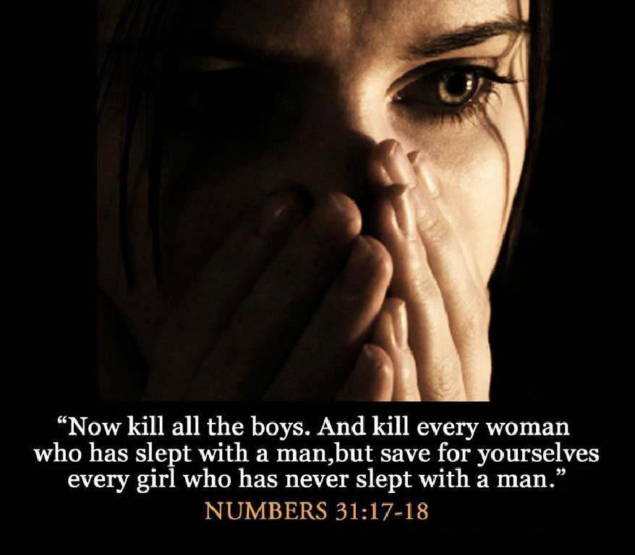
"Therefore, I will throw her on a bed of suffering, and those who commit adultery with her will suffer greatly unless they repent and turn away from her evil deeds. ²³I will strike her children dead…" (2:22-23a NLT)

Slide 53
Thyatira (Rev. 2:18-29)
355
Warning
I am bringing her [Jezebel] violent illness, and adulterers with her into terrible suffering, unless they repent; and I will strike her followers with a deadly disease, and then all the churches will know that I am the one who searches minds and hearts. I will repay each one of you what your deeds deserve.
Pergamum
Thyatira
Exhortation
Repent!
Hold on to what you have
Rebuke
Tolerates Jezebel with her immorality and idolatry
Christ: The Son of God with eyes like blazing fire and feet like burnished brass
Commendation:
Deeds, love, faith, service, perseverance, doing more than at first
Smyrna
Sardis
Ephesus
Philadelphia
Laodicea

Slide 54
The Cure for AIDS

Slide 55
Faithful believers must persevere (2:24-25)
Notes:
"To all who have not learned the so-called "deep secrets of Satan," I do not burden you further; however, hold what you have until I come."
Does Jesus really just expect some of us simply to remain faithful to the truth we have been taught (24-25)?
Yes, he expects perseverance, since growth and blessing are his responsibility.
Since the church was so small, Jesus did not ask them to leave it but to remain until he purged it of false teachers.
We often think we need to do great things for Christ. Actually, it is HE who does the great things! He only asks us to remain faithful.
Obviously, those caught up in immorality were not faithful!

Slide 56
How does Jesus respond to immorality among believers?

Slide 57
IV. Jesus rewards faithfulness (2:26-29).

Slide 58
Thyatira (Rev. 2:18-29)
355
Promise
Will have authority over the nations and the morning star
Warning
I am bringing her [Jezebel] violent illness, and adulterers with her into terrible suffering, unless they repent; and I will strike her followers with a deadly disease, and then all the churches will know that I am the one who searches minds and hearts. I will repay each one of you what your deeds deserve.
Pergamum
Thyatira
Exhortation
Repent!
Hold on to what you have
Rebuke
Tolerates Jezebel with her immorality and idolatry
Christ: The Son of God with eyes like blazing fire and feet like burnished brass
Commendation:
Deeds, love, faith, service, perseverance, doing more than at first
Smyrna
Sardis
Ephesus
Philadelphia
Laodicea

Slide 59
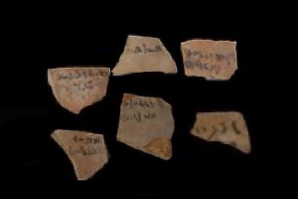
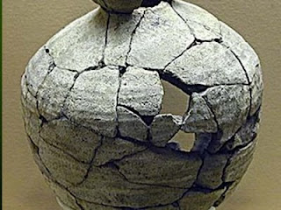
Thyatira
355
To all who are victorious, who obey me to the very end,
To them I will give authority over all the nations.
²⁷They will rule the nations with an iron rod and smash them like clay pots.
Rev. 2:26-27 NLT

Slide 60
The Overcomers (Rev. 2–3)
365
Pergamum
Thyatira
"He who overcomes" (NAU) is used once for each of the 7 churches, plus 21:7 with a total of 8 times in Revelation
Smyrna
Sardis
Ephesus
Philadelphia
Laodicea

Slide 61
The Overcomers (Rev. 2–3)
365
Pergamum
Thyatira
To him who overcomes, I will grant to eat of the tree of life which is in the Paradise of God (2:7)
Smyrna
Sardis
Ephesus
Philadelphia
2:7
Laodicea

Slide 62
The Overcomers (Rev. 2–3)
365
Pergamum
Thyatira
He who overcomes will not be hurt by the second death (2:11)
Smyrna
Sardis
2:11
Ephesus
Philadelphia
2:7
Laodicea

Slide 63
The Overcomers (Rev. 2–3)
365
Pergamum
Thyatira
To him who overcomes, to him I will give some of the hidden manna, and I will give him a white stone, and a new name written on the stone which no one knows but he who receives it (2:17)
2:17
Smyrna
Sardis
2:11
Ephesus
Philadelphia
2:7
Laodicea

Slide 64
The Overcomers (Rev. 2–3)
365
Pergamum
Thyatira
2:17
2:26
He who overcomes, and he who keeps My deeds until the end, TO HIM I WILL GIVE AUTHORITY OVER THE NATIONS (2:26)
Smyrna
Sardis
2:11
Ephesus
Philadelphia
2:7
Laodicea

Slide 65
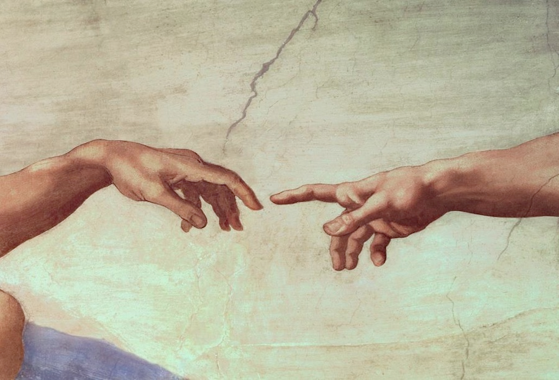
Are you ready to rule the world?

Slide 66
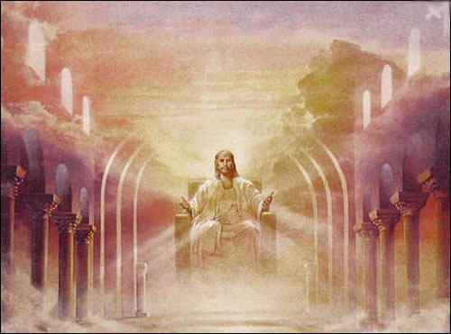
The Rule of Christ
Psalm 2:8-9 quoted in Rev. 2:27

Slide 67
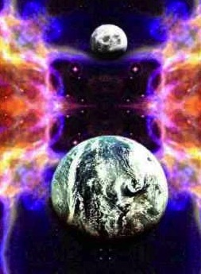
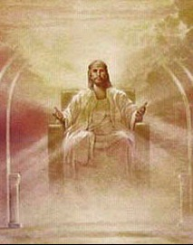
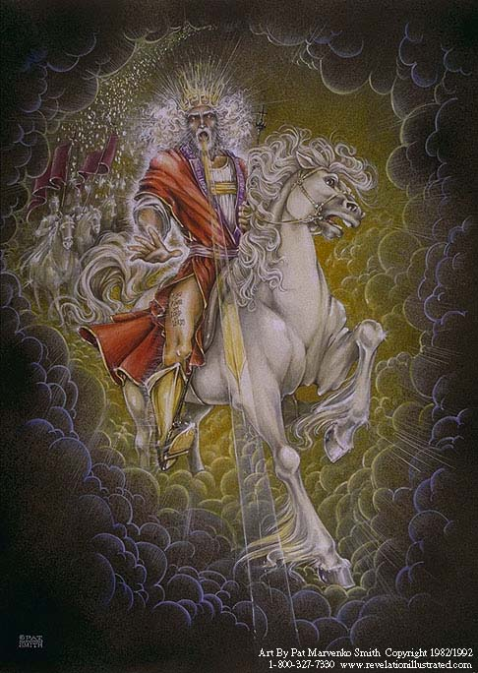
Our Future (Rev. 19–20)
Heaven (Rev. 21–22)
Millennium (Rev. 20)
Return (Rev. 19)

Slide 68
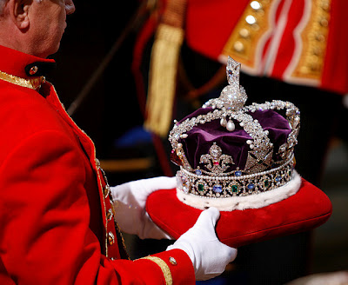
The Future Reign of the Servant Kings
Jody Dillow share much about our rule with Christ
Final Destiny
The Future Reign of the Servant Kings
Joseph Dillow

Slide 69
Revelation 20:4 (NAU)
⁴Then I saw thrones, and they sat on them, and judgment was given to them. And I saw the souls of those who had been beheaded because of their testimony of Jesus and because of the word of God, and those who had not worshiped the beast or his image, and had not received the mark on their forehead and on their hand; and they came to life and reigned with Christ for a thousand years.

Slide 70
"Do you not know that saints will judge the world?" (1 Cor. 6:2a)

Slide 71
"If we endure hardship, we will reign with him" (2 Tim. 2:12 NLT)

Slide 72
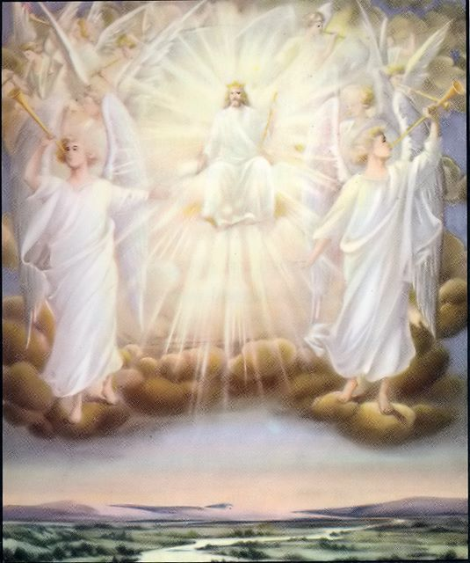
"Those who are victorious will sit with me on my throne, just as I was victorious and sat with my Father on his throne" (Rev. 3:21 NLT).

Slide 73
How does Jesus respond to immorality among believers?

Slide 74
Service is no substitute for spotlessness
Main Idea:
Notes:
Activities can't replace adoration.
Good works can't replace godliness.
Perseverance can't replace purity.

Slide 75
How does Jesus respond to immorality among believers?
Judges
Commends
Discerns
Rewards

Slide 76
Porn-Again Christian

Slide 77
For No Porn-Again:
Strict filter
Accountability

Slide 78
Title
Your Brain on Porn

Slide 79
Black

Slide 80
Jesus Wins!
Series on Revelation

Slide 81
NT Sermons link at biblestudydownloads.com
Get this presentation for free!

